Slide 1
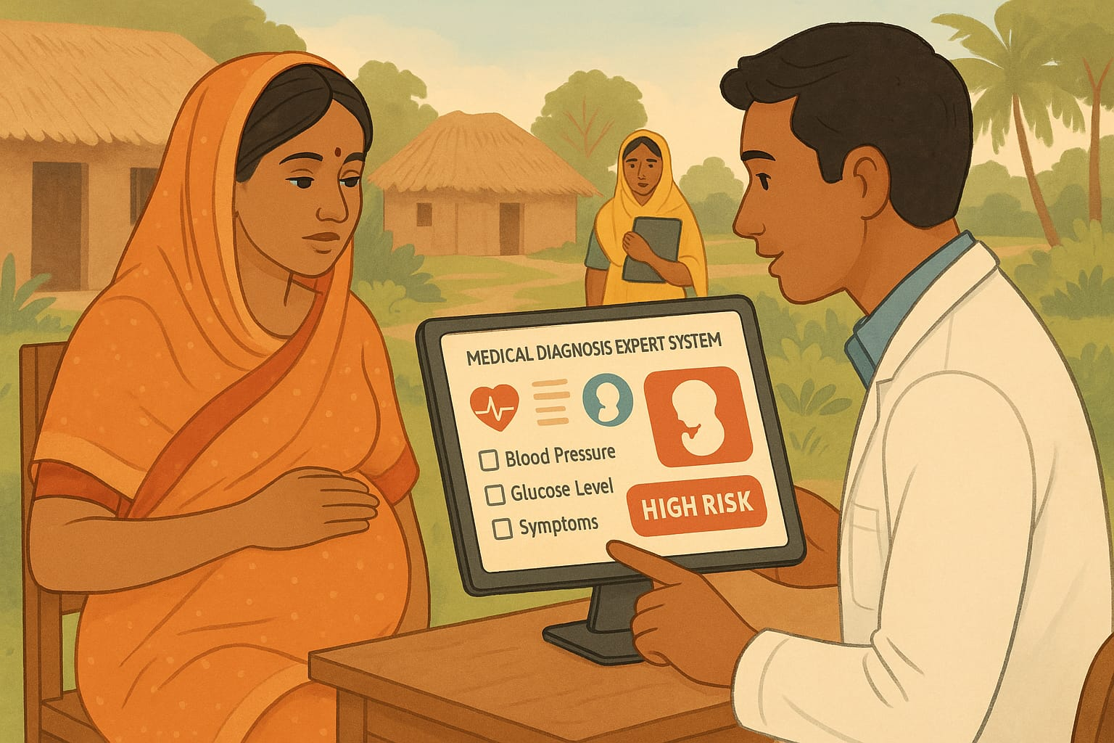
Medical Diagnosis Expert System: Maternal health risk assessment
Group Members:
Abdul Zabbar Dewan | 2013222042
Md Tamim Ahamed | 2014286042
Mir Bayazid Protik | 1921085042
Sayeb Rayat | 2012733042

Slide 2
Motivation:
During pregnancy, a woman is likely to experience unfavorable health conditions which is referred as Maternal Health Risk. Pregnancy complications can be classified to high or low Risk category based on the maternal health risk factors. Globally, 21 million pregnant women experience complications during pregnancy each year. Nationwide, for example, in Bangladesh, pregnant women experience 173 deaths per 100,000 live births, for inaccessible healthcare and poverty. These high Risk include postpartum hemorrhage and infections.
Instead of manual detection through clinical assessments a more modern approach would be to detect using the power of machine learning which motivated us to do our project to do classification of health risk from the associated risk factors during pregnancy.

Slide 3
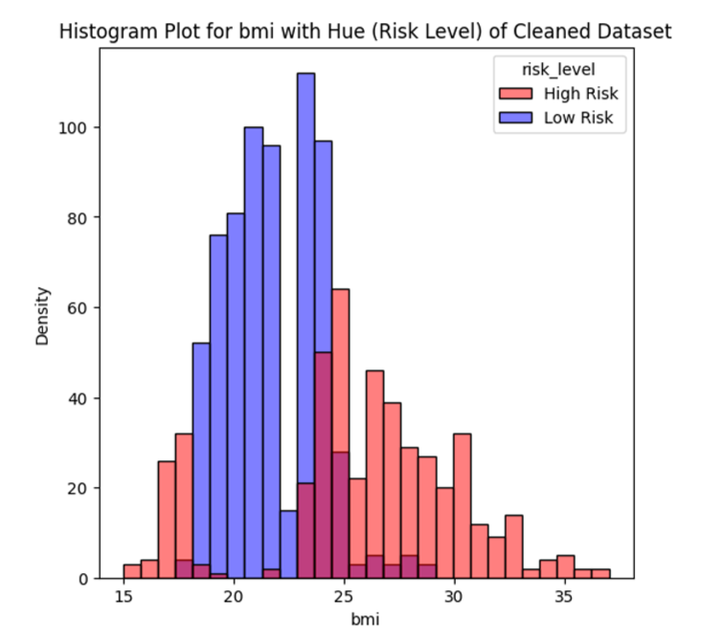
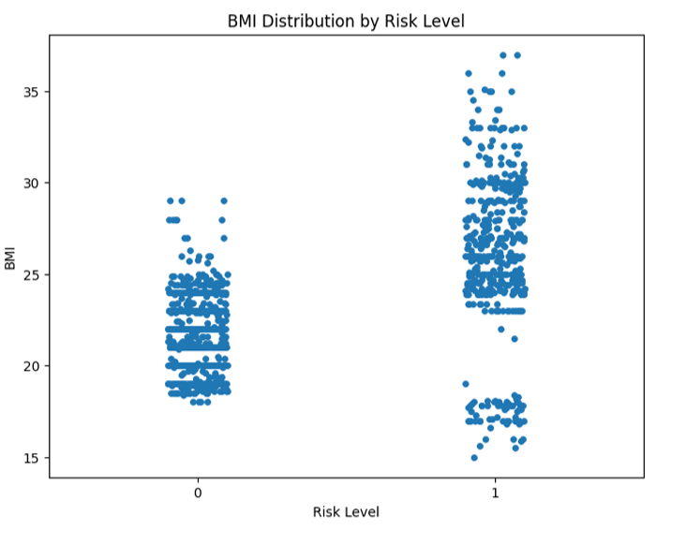
Exploratory Data Analysis:

Slide 4
Machine Learning Models
We have used three machine learning models.
Models | Accuracy | F1 Score | Recall | Precision
KNN | 0.9697 | 0.9696 | 0.9697 | 0.9699
SVM | 0.9610 | 0.9609 | 0.9610 | 0.9612
Decision Tree | 0.9957 | 0.9957 | 0.9957 | 0.9957

Slide 5
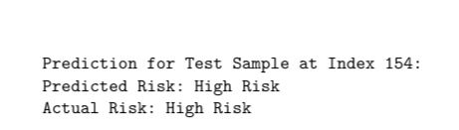
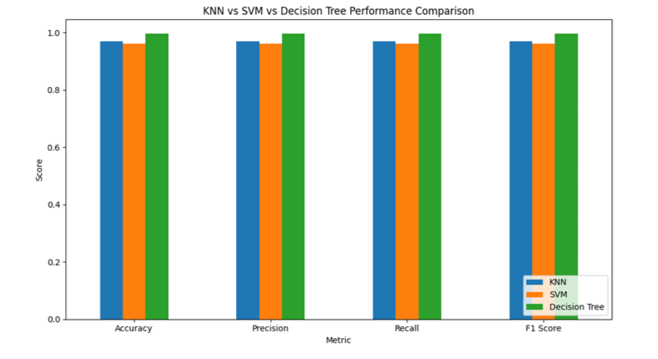
Results
The Decision Tree model achieved the highest accuracy of 99%.
Model testing:

Slide 6
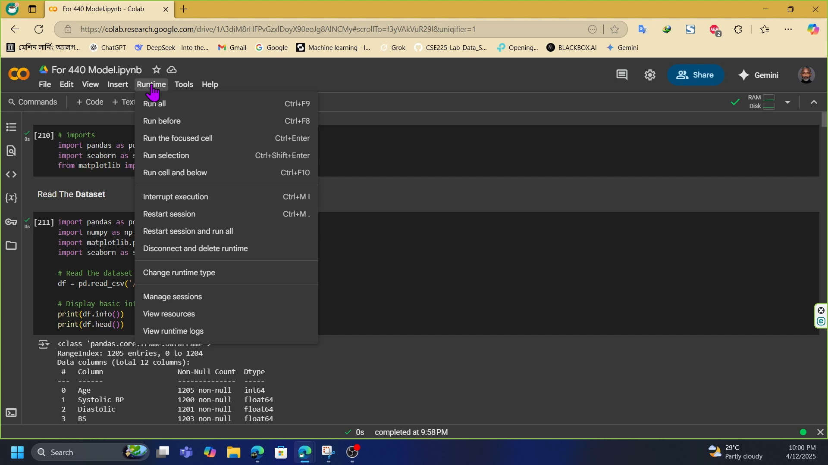
Video demo:

Slide 7
Thank you For your time Any questions !?

